Slide 1

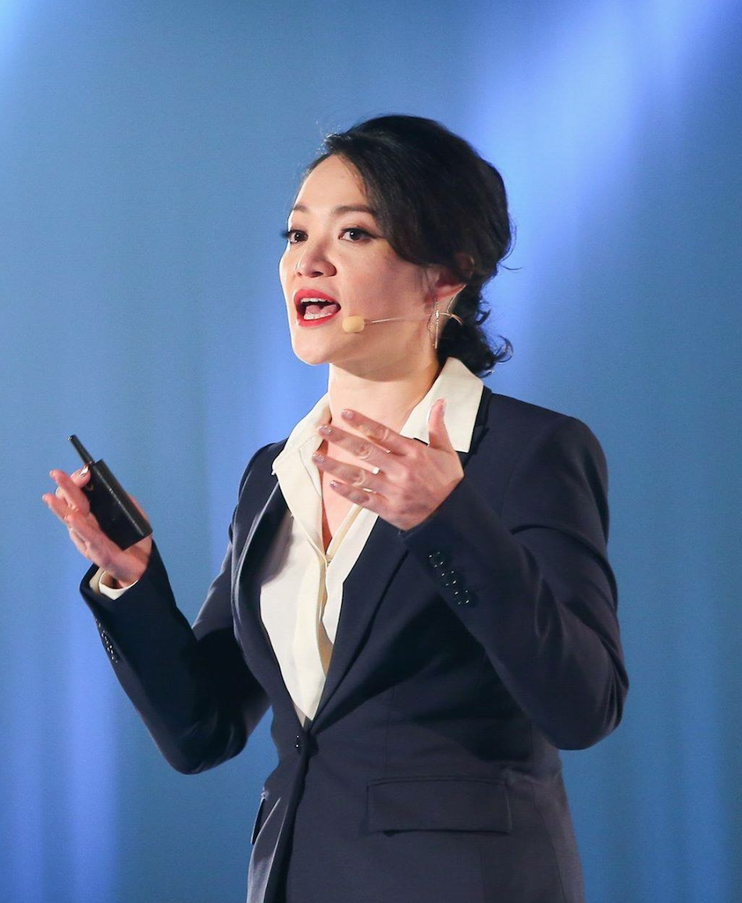

夢想規劃與目標設定
Dreams and Goal Setting
Stella Huang
執行高級顧問經理級
Executive Director
四個佣金週期共賺取HK$191,600
HK$191,600 in 4 Commission weeks
本簡報中提到的收入等級純屬舉例說明，無意代表美安香港超連鎖™店主的一般收入，也無意表示任何超連鎖™店主皆可賺取同等收入。美安香港超連鎖™店主的成功與否，取決於其在發展事業時的努力、才能與投入程度。
The income levels mentioned in the following presentation are for illustration purposes only. They are not intended to represent the income of a typical Market Hong Kong UnFranchise ™Owner, nor are they intended to represent that any given Independent UnFranchise ™ Owner will earn income in that amount. The success of any Market Hong Kong Independent UnFranchise ™ Owner will depend upon the amount of hard work, talent, and dedication which he or she devotes to building his or her Market Hong Kong Business.

Slide 2




FOLLOW ME ON SOCIAL MEDIA
facebook.com/stellahuang

Slide 3
Stella Huang
EXECUTIVE DIRECTOR
HK$191,600/4 weeks
Gold Master UFO
SAMM All Star
Chairman’s/WebCenter/TLS Challenge Qualifier
Best Certified Trainer of 2013
Member of Taiwan Leadership Council
Member of Advisory Council
Member of Million Club
本簡報中提到的收入等級純屬舉例說明，無意代表美安香港超連鎖™店主的一般收入，也無意表示任何超連鎖™店主皆可賺取同等收入。美安香港超連鎖™店主的成功與否，取決於其在發展事業時的努力、才能與投入程度。
The income levels mentioned in the following presentation are for illustration purposes only. They are not intended to represent the income of a typical Market Hong Kong UnFranchise ™Owner, nor are they intended to represent that any given Independent UnFranchise ™ Owner will earn income in that amount. The success of any Market Hong Kong Independent UnFranchise ™ Owner will depend upon the amount of hard work, talent, and dedication which he or she devotes to building his or her Market Hong Kong Business.

Slide 4
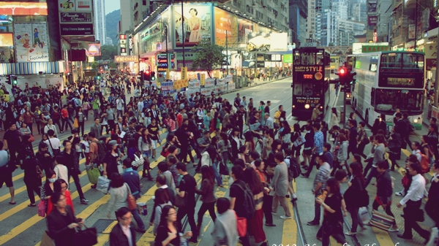
Are we Surviving? Or Living? Is Work-life Balance a Reality?
Are we Surviving? Or Living? Is Work-life Balance a Reality?

Slide 5
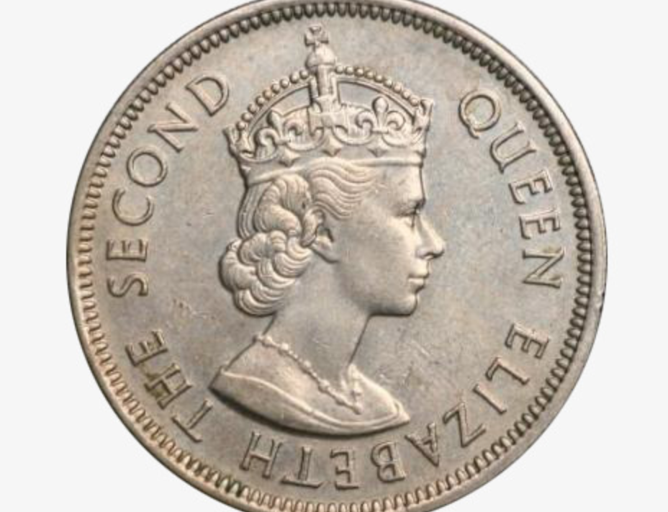

How “deficiency” turns us to be poor.
We are trapped in deficiency.
Tunnel Vision
  We always focus on the urgent problem in front of us and overlook those are more important.
  There is limitation in our brain. We are sick of calculate. We rely on “habit” to live comfortably.
  Ex. Escaping the important issues
  PRICE rather than VALUE
  Give out our time and get money back
  Ill-considered and improvident

Slide 6

Start MAKING your dream
You have the WHY, we have the HOW

Slide 7
Achieve the dream $138,000/4W
Director May 2023
Family no need to worry about financial condition $76,600/4W
National Supervising Coordinator May 2021
Housing debts $34,500/4W
Professional Coordinator May 2019
Accumulated short-term targets can reach a long-term target
本簡報中提到的收入等級純屬舉例說明，無意代表美安香港超連鎖™店主的一般收入，也無意表示任何超連鎖™店主皆可賺取同等收入。美安香港超連鎖™店主的成功與否，取決於其在發展事業時的努力、才能與投入程度。
The income levels mentioned in the following presentation are for illustration purposes only. They are not intended to represent the income of a typical Market Hong Kong UnFranchise ™Owner, nor are they intended to represent that any given Independent UnFranchise ™ Owner will earn income in that amount. The success of any Market Hong Kong Independent UnFranchise ™ Owner will depend upon the amount of hard work, talent, and dedication which he or she devotes to building his or her Market Hong Kong Business.
Housing debts $34,500/4W
Professional Coordinator Feb. 2019

Slide 8
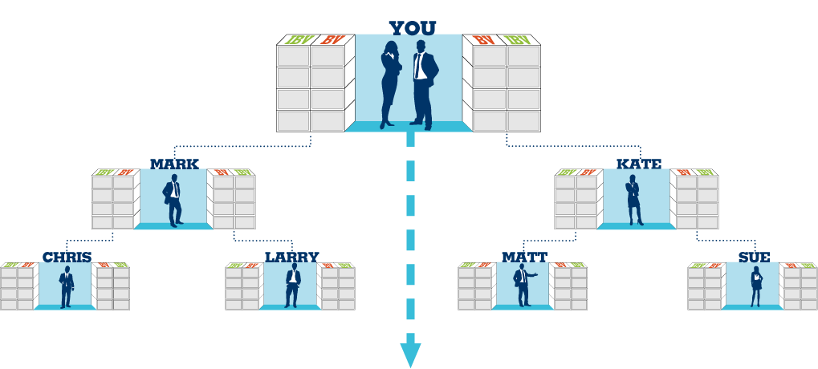
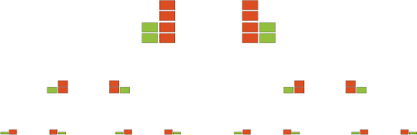
Organization complete monthly target and Basic 10 customers
Commission = Monthly$46,000 (BV)and Monthly$23,000 (IBV)
Month target
each UFO monthly 200 BV + 20 IBV
Basic 10 customers
Each UFO’s 10 best customers generate
300 BV + 200 IBV
Total amount = Each UFO 500 BV + 220 IBV
Each cycle you can earn BV $11,500 and every 2 cycles earn IBV $11,500
50 UFO’s x 500 BV = Month25,000 BV
And
50 UFO’s x 500 BV = Month25,000 BV
50 UFO’s x 500 BV = Month25,000 BV
And
50 UFO’s x 200 IBV = Month10,000 IBV
BV and IBV on this slideshows the accumulated cycle figures

Slide 9
Duplicable
Action plan
Shopping Annuity Master Member/quarter
Master UFO/quarter
Challenge/half year
Goal
Build up a team of Basic 10, Strong 7
The most powerful tool:
Event tickets

Slide 10
SMART Action targetSetting
Start with a feeling & idea. Stay with your original intention! EX. Leave your job now. Get back your freedom!
S | SPECIFIC | Accurate | Professional Coordinator
M | MEASURABLE | A measurable target Digitization | $34500/4W
A | ATTAINABLE Action-oriented | Action-oriented | Separate into small tasks
R | RELEVANT Result-oriented Resource | Consider the factors in reality Result-oriented Resource integration | Possible action plan per day/week/month/quarter Achieve SAMM, MUFO & Challenge Making use of training system of team and company
T | TIMELY | Deadline | 2019.5 MHK Annual Convention

Slide 11
Focus on daily and weekly result-producing action plan
(Started Guide)
 | Day | Week | Month | Quarter | Year
Training | Audio Reading | Group CR CWS | B5 Major | LS/ECCT 1~3 books | 2 events
Retail | share your own product reviews and opinions Read the posts from your friends | 125BV+50IBV Customers follow up | 500BV+200IBV Customer Relationship Shopping Annuity | UFO Challenge Winner Shopping Annuity | Product Symposium
Recruiting | 3/1/2 10/3/2 | UBP/2 to 1 Following Meeting | Sponsoring 1 person Follow up training | UFO Challenge Winner
Time investment | 30min Time for food | 2~3 nights | 6~9 hrs in weekend |  | 3 weekends
Financial investment | Comprehensively spending conversion | Transportation fee | Ticket | Ticket/Tool | 6~20 tickets
Other supports | Dream board Goal and commiment | Report and discussion with sponsoring | Retail profit |  | Commission + Retail Cashback

Slide 12
Obstacles, are the challenges for the one who are achieving their dreams.
Distraction
vs.
Concentration
Excuses
vs.
Methods
Have a try
vs.
Must succeed

Slide 13
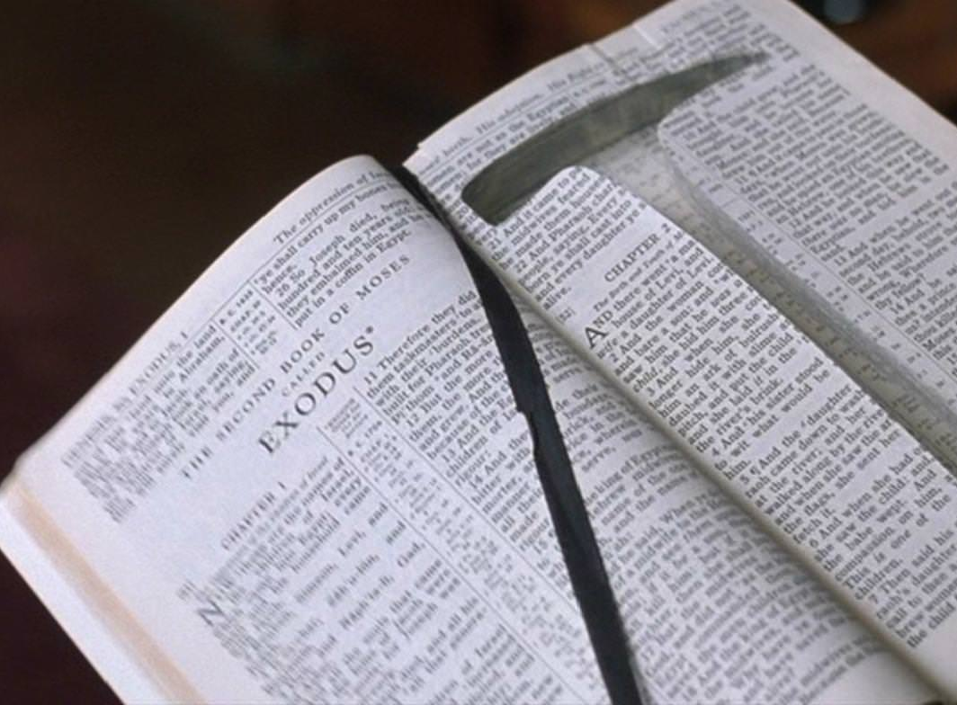


Deficiency draws us to concentrate.
Actions result in success.
Your dream, your family and your
future are worth enough for you
to give all your efforts.

